Slide 1
The role of Open Mapping for Sustainable Urban Development
David Luswata | @lusdavo
Humanitarian OpenStreetMap Team (HOT)

Slide 2
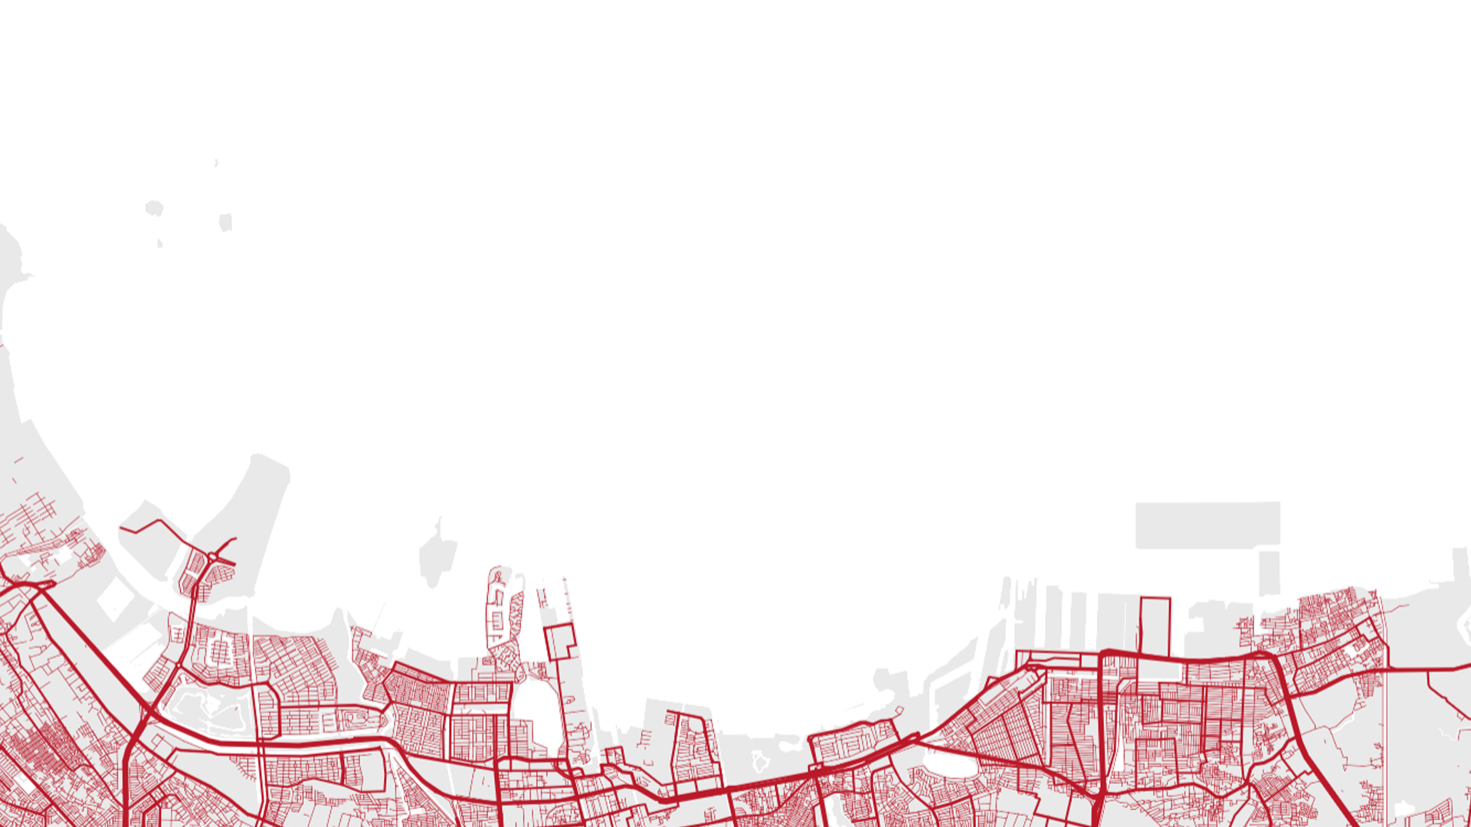
Who we are
Statement of the problem
Open mapping solutions
Outline
Methodology, Implementation Plan & Activities
Final or Preliminary Results/Outputs
Conclusion/Expected Outcomes
Proposed application areas of Open Mapping
Stakeholders, Users and Acknowledgement
How we can collaborate

Slide 3
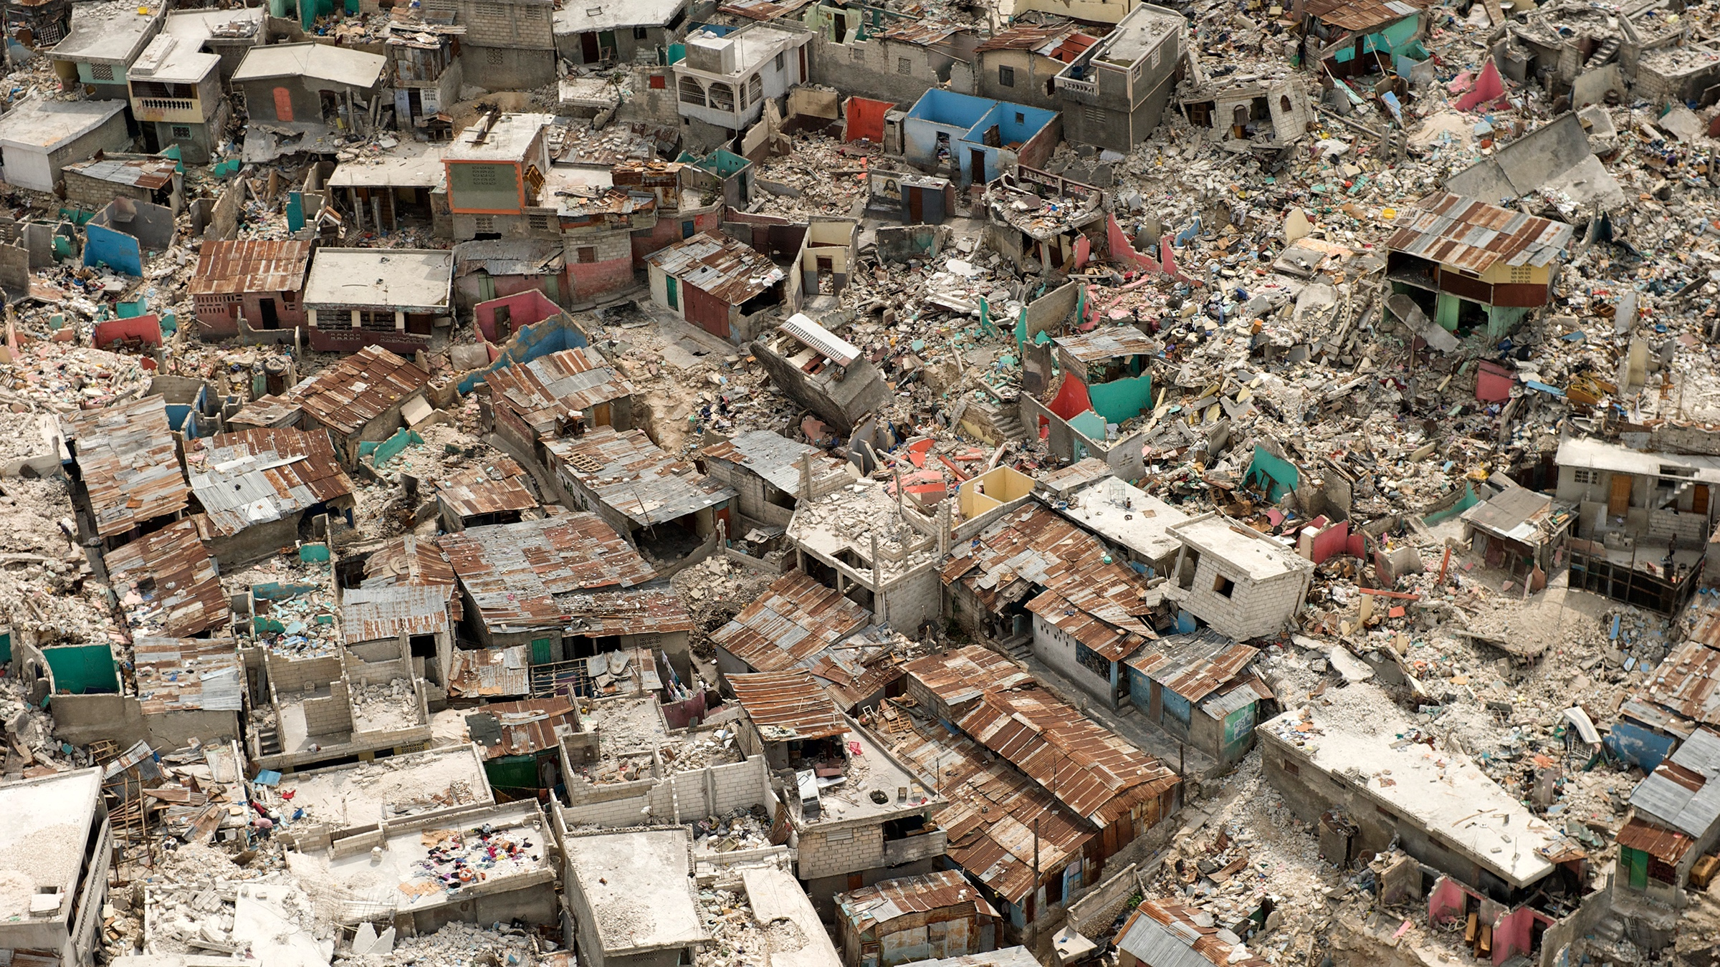
Who we are
HOT is an NGO which supports communities and OpenStreetMap contributors, mapping areas vulnerable to disaster, and to support development initiatives
Notes:
We leverage crowdsourcing & technology to provide data & improve coordination for disaster response and development initiatives

Slide 4
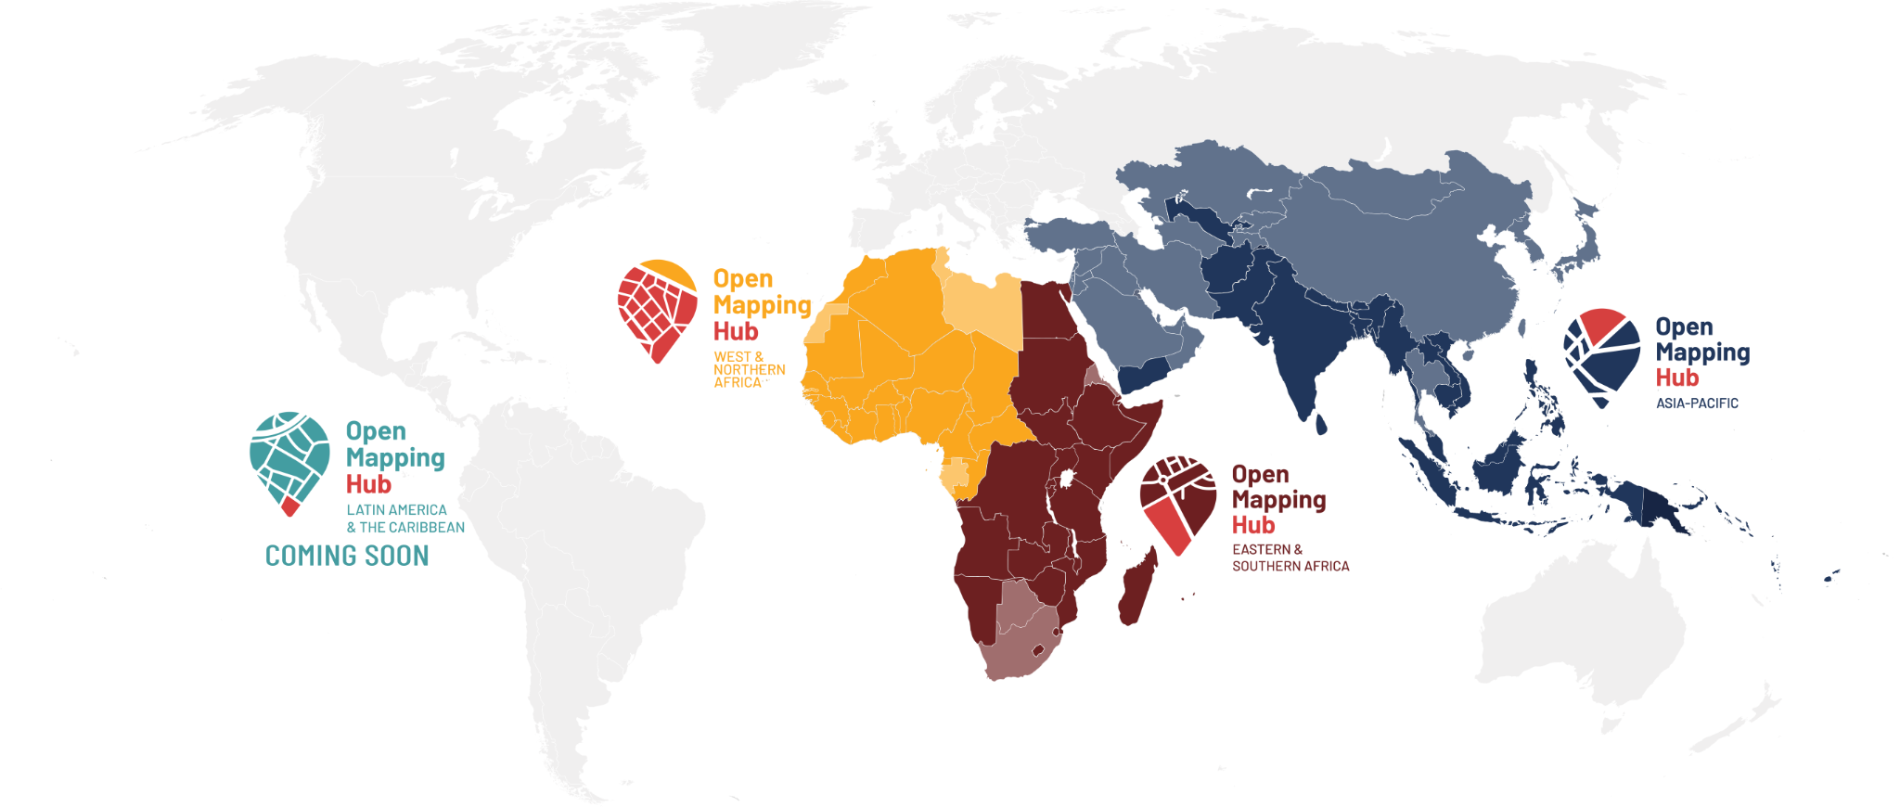
HOT is strengthening OpenStreetMap & open data in 4 priority regions
1
Connect NGOs, Governments and local communities so that they can use open data in decision-making
2
Work with partners to create free and shareable data in OpenStreetMap
3
Inspire and mobilize an OpenStreetMap movement across each region, supporting the growth of vibrant OpenStreetMap ecosystems
Link: priority countries list
Notes:
While map data exists in many locations that’s readily available to use in your work - there are many places which are not well captured on a digital map. That’s why our models involves providing local people with local open tools to make decisions locally.
HOT has set up regional Open Mapping Hubs in Asia-Pacific, Eastern and Southern Africa, West and Northern Africa, and Latin America and the Caribbean, which will engage with local mapping communities, facilitate knowledge exchanges, distribute funding, and provide training and support in order to massively scale local edits to OpenStreetMap in 94 countries.
The maps & information can be used in decisions local, national and regional actors. The teams in each region - here to help you create, access and use OSM data for hum & dev decisions.
# of countries by region https://wiki.openstreetmap.org/wiki/Humanitarian_OSM_Team/Priority_countries#HOT_Priority_Country_list_by_region:
Asia/Pacific: 25
Eastern & Southern Africa: 23
West & Northern Africa: 24
Latin America & Caribbean: 22
Total: 94

Slide 5
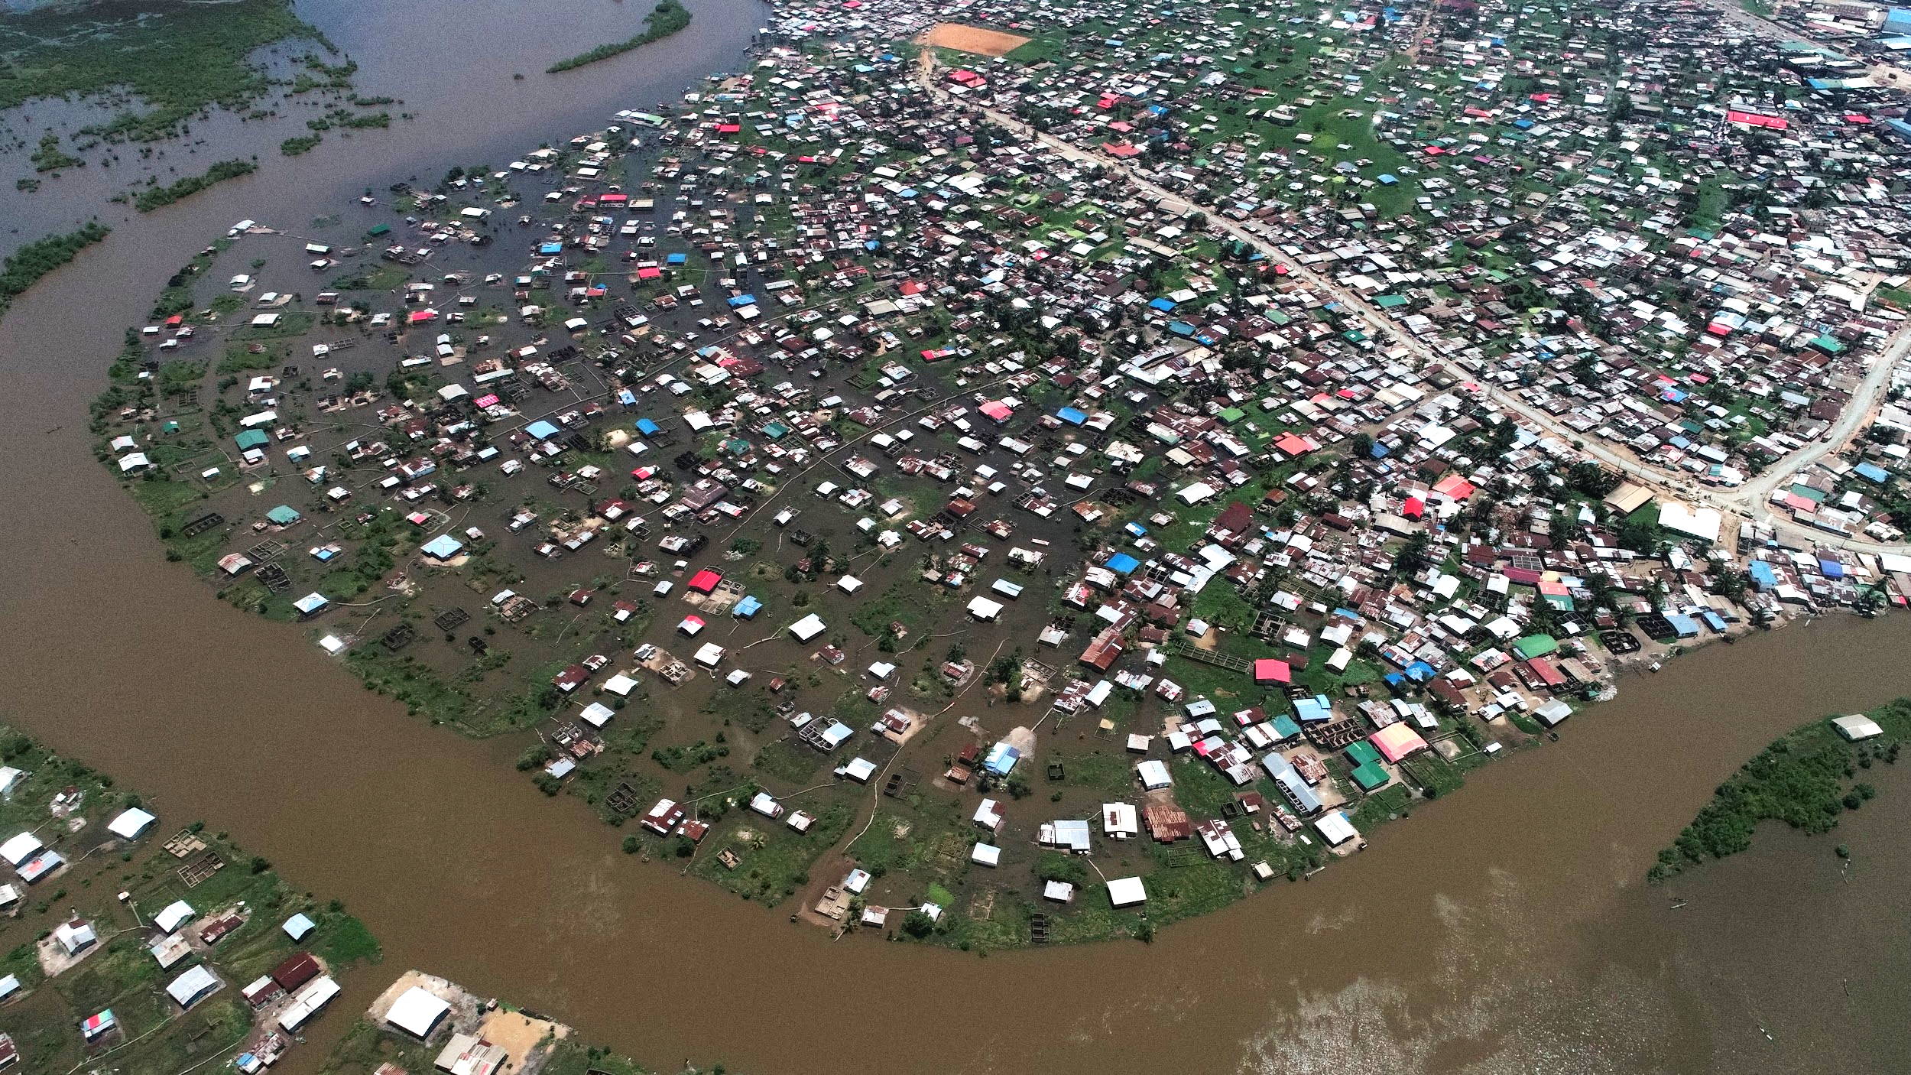
Statement of the problem
In most cities such as Dar es Salaam, Monrovia, Windhoek or Kampala, rapid urbanization and unplanned growth are major issues. These have led to informal settlements establishment, strained access to basic services and increasing numbers of people at risk of humanitarian crises.
Sustainable Urban Development focuses on SDG11
In 2018, 4.2 billion people, 55 percent of the world’s population, lived in cities.
In the coming decade, 90 percent of urban expansion will be in the developing world.
Notes:
HOT Implemented projects in this area: Ramani Huria, Open Cities Accra, Open Cities Monrovia, Open Cities Bamako, Uganda Open Mapping Project, Open Cities LAC,

Slide 6
Open mapping solutions
Investments in a data ecosystem that supports citizen-generated data alongside official data sources empowers sustainable urban planning, provide a holistic understanding of development and disaster risk. This leads to supporting inclusive decision-making resulting in more livable and sustainable cities.
HOT has implemented over 8 projects and microgrants in this areas in over 12 countries
Urban dwellings and infrastructure including access to basic services, waste management, transport, resilience, public health.
Open data and open mapping processes and tools provides low-cost, high-return ways of designing and developing sustainable urban environments.
Link to video
Notes:
HOT Implemented projects in this area: Ramani Huria, Open Cities Accra, Open Cities Monrovia, Open Cities Bamako, Uganda Open Mapping Project, Open Cities LAC
Video by GFDRR about growth of OSM in Africa: https://youtu.be/328t90vkots

Slide 7
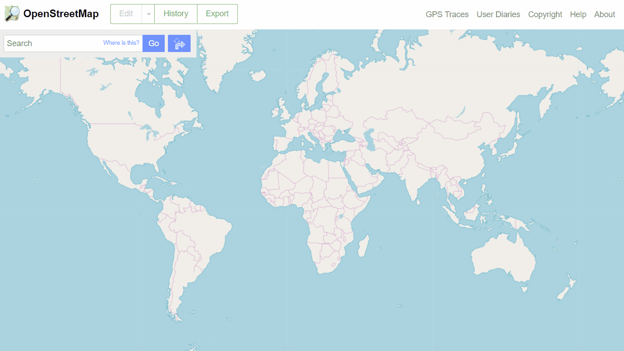
Methodology, Implementation Plan & Activities
OpenStreetMap
is a collaborative project to create a free editable map & source of geospatial data.
OpenStreetMap can be used in a wide range of domains (i.e. domain agnostic)
https://osm.org/
Notes:
We’re working together to build a free and open map of the world - using OpenStreetMap (what you can see in the background) which is like the Wikipedia of maps. It’s a PUBLIC GOOD so that valuable data can be used by all local actors. That means all data on OpenStreetMap is free and open to access, use, download, incorporate in offline analysis, applications, etc.

Slide 8
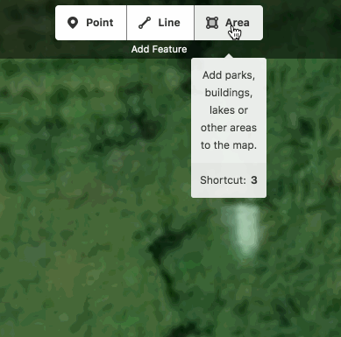
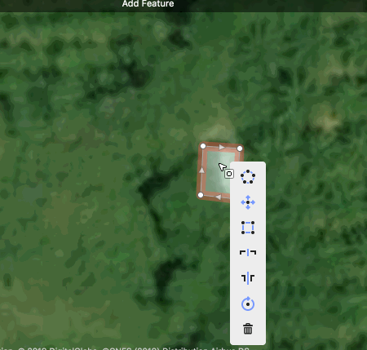
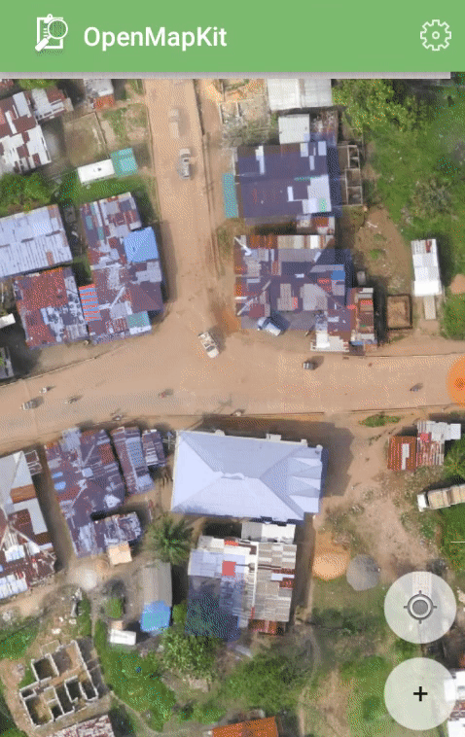
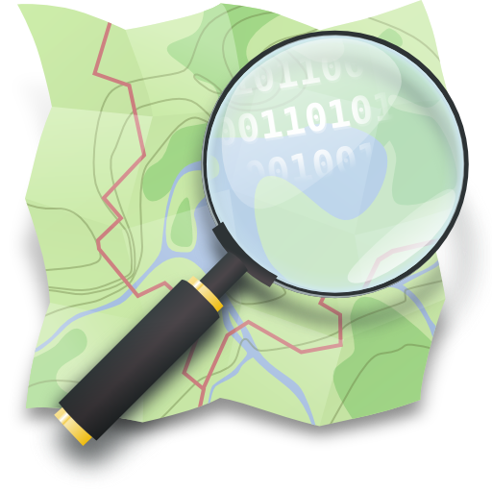
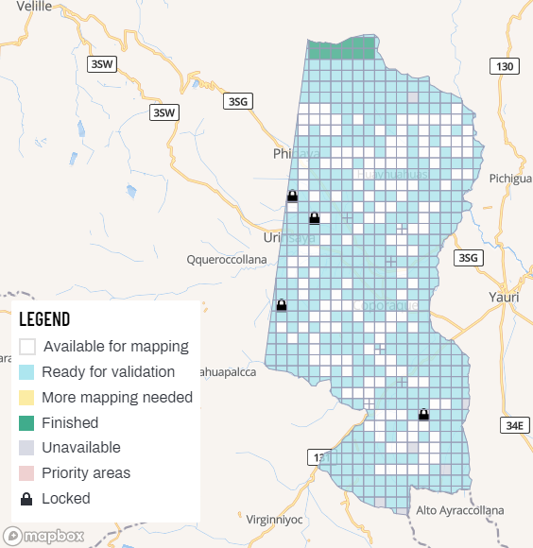
Methodology, Implementation Plan & Activities
1
2
3
Remote mapping: from anywhere using a browser, tracing buildings and/or roads.
Our Tasking Manager allows you to do this
Field mapping: Range of Android apps to add varying levels of local detail. Collect info such as residential infrastructure (material of houses, # of floors), water points, health centres, bridges
Outcome: Citizen-generated and ground truthed data in OpenStreetMap that can be used in a variety of areas
https://osm.org/
http://tasks.hotosm.org
Notes:
HOT is most recognized by a piece of software we built for OSM, called the Tasking Manager. At its most basic, the Tasking Manager takes an area you want to map and splits it into manageable pieces that mappers can ‘check out’ to let others know they are working there. As simple as it is, the TM has greatly reduced - not eliminated - duplication of efforts, conflicts when multiple mappers try to edit the same object, etc. And has allowed HOT, and over 100 other organizations to effectively manage mapping projects.

Slide 9
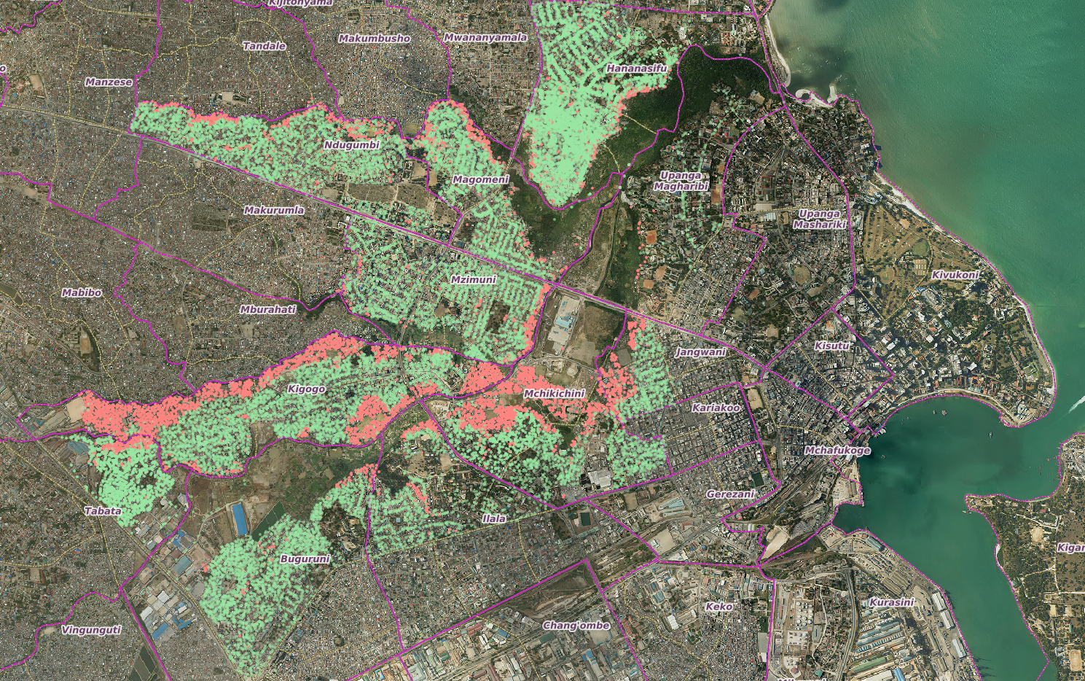
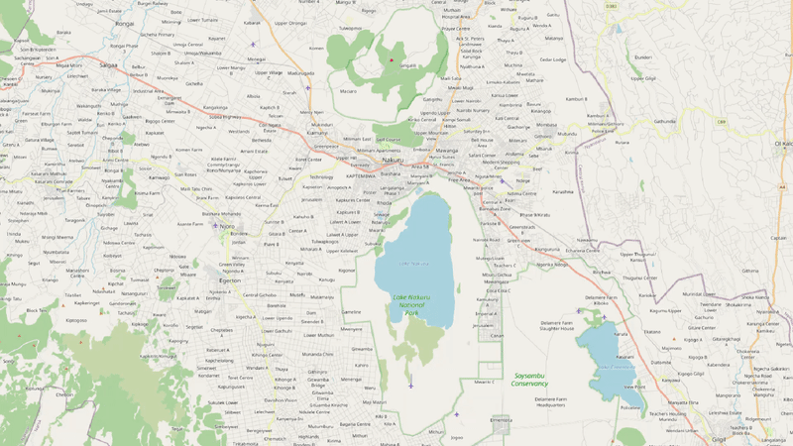
Final or Preliminary Results/Outputs
Dar es Salaam, Tanzania
Nakuru, Kenya
Liberia Cities
Improve understanding of urban infrastructure to inform maintenance and planning.
Build local skills and capacity. Engage communities, train next generation of town planners, encourage local leadership.
Insights from training and location based analysis to inform decision making
Over 1.3 million buildings mapped in Nakuru and other parts of Kenya
Mapping for service delivery and decentralization in Gbarnga, Gompa and Zwedru Cities
All building, social amenities, solid waste points, businesses and administrative boundaries mapped
Improved service delivery

Slide 10
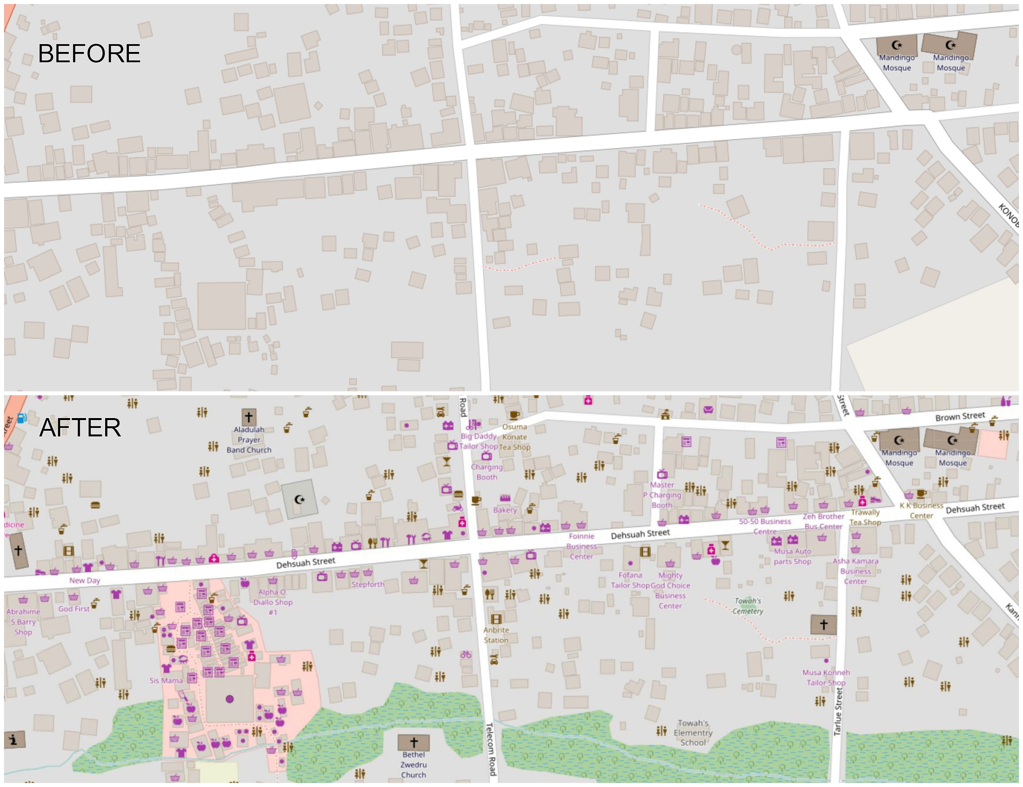
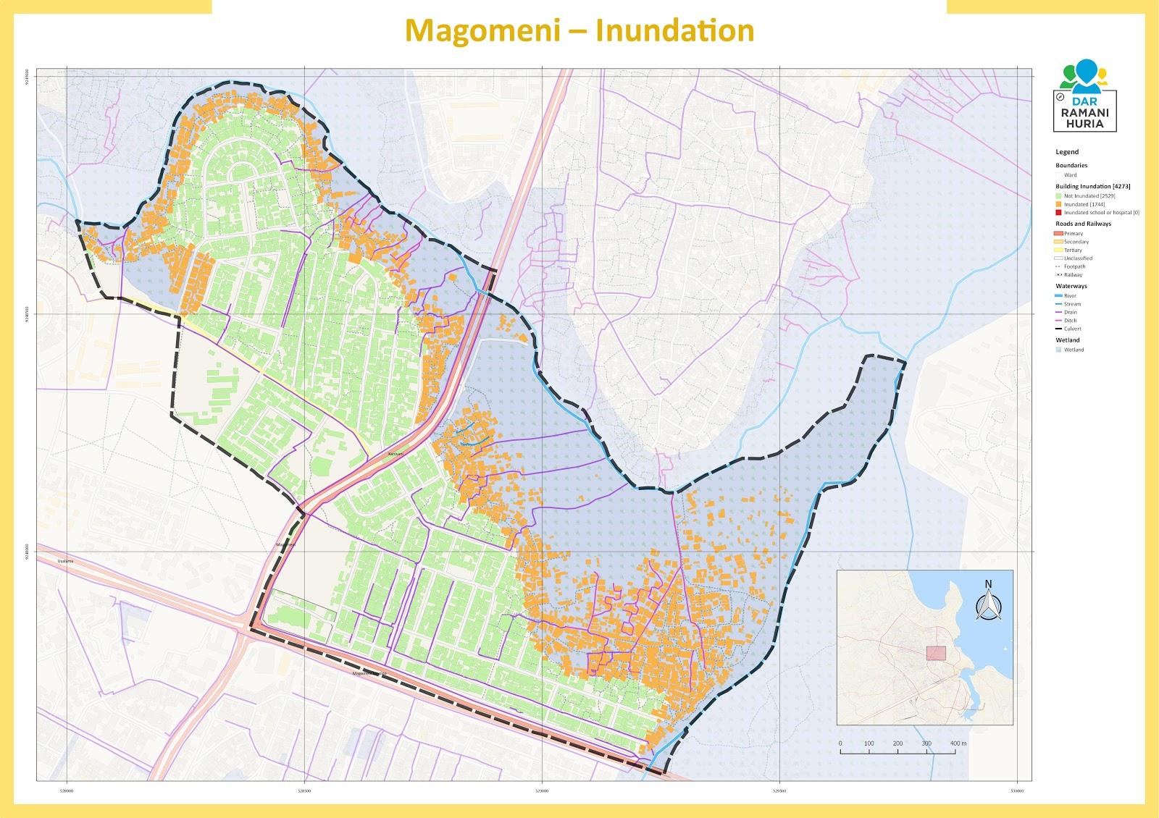
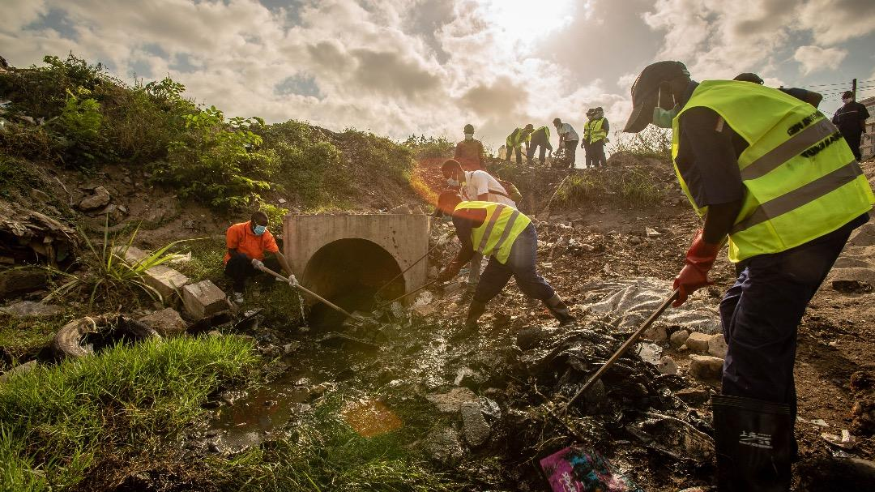
Conclusion/Expected Outcomes
Open Mapping and Citizen Generated Data
Open mapping initiatives have contributed to empowerment and participation of local actors in creating dataset about their communities.
Citizens – individuals and communities – are important actors in the data revolution
Citizen-generated data initiatives contribute to specific improvements in the delivery of development-related projects.

Slide 11
Proposed application areas of Open Mapping
Open mapping initiatives, processes and tools can lead to the creation and use of earth observation data for sustainable development. Application of open mapping could include:
Mapping for sustainable urban environments
Open spaces, drainage systems, solid waste management, building footprints, street naming, addressing systems, amenities
Mapping for climate resilience
Building footprints, flood prone neighbourhoods, drainage systems, solid waste management, place names, advocacy, informal settlements mapping
Mapping for migration and displacement
Place names, points of entry, building footprints, livelihood facilities, amenities
Mapping for public health programs
Health facilities and other amenities, place names, building footprints
Mapping for development programming such as delivery of services
Building footprints, businesses, socio-economic facilities
Academia
Improving academic programs harnessing modern trends of cartography
Technology
Drones, mobile data collection, AI and ML feature detection

Slide 12
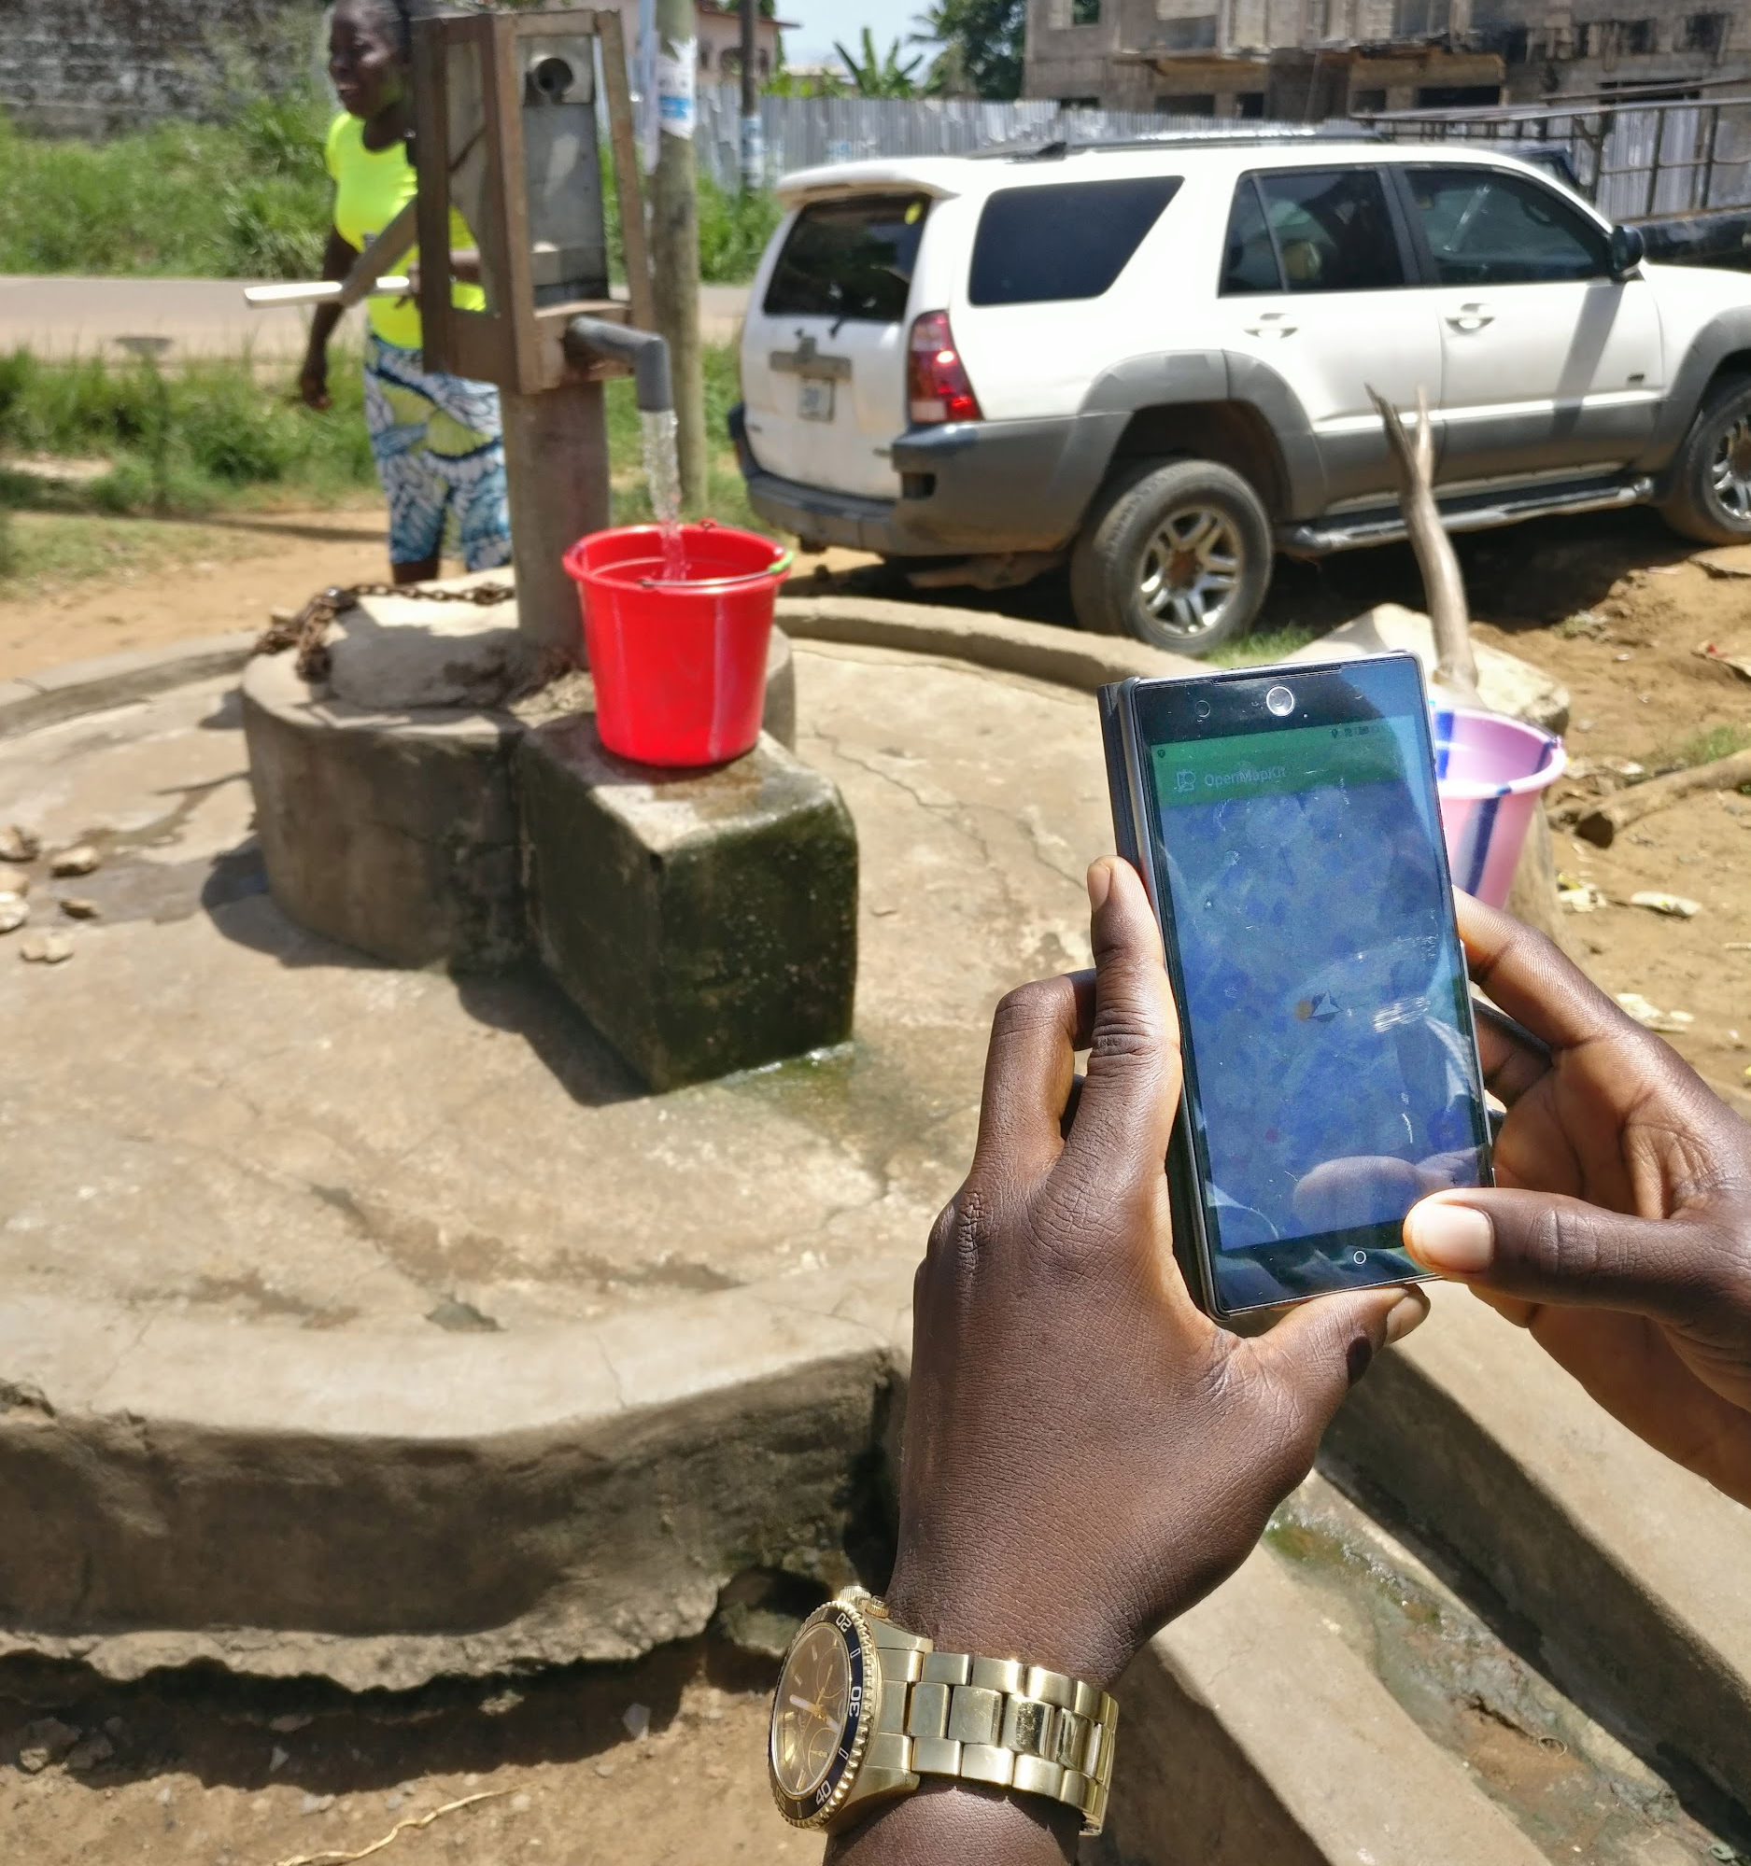
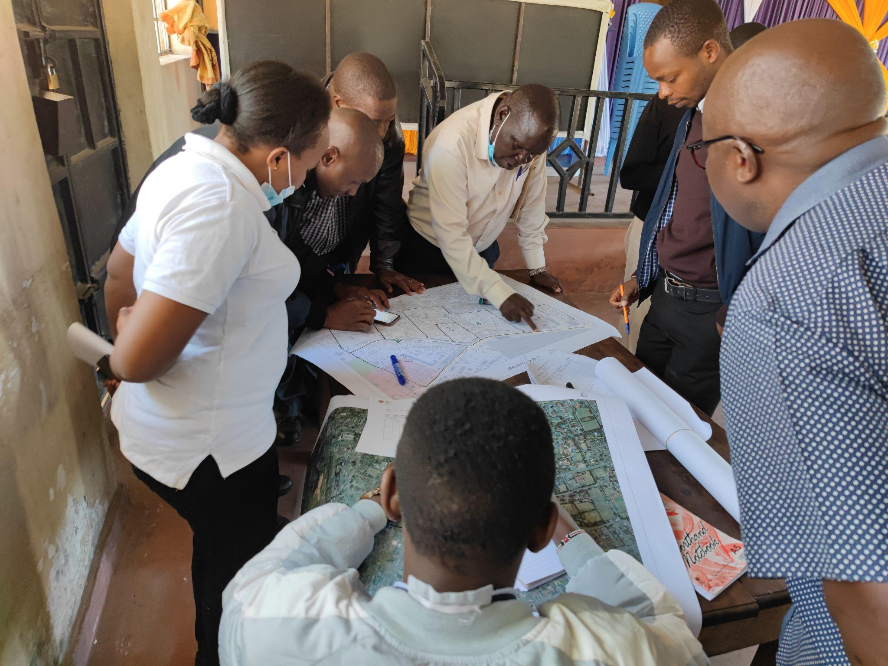
Let’s collaborate on global & local challenges…
Access to free, detailed, up-to-date maps for the areas you work in (e.g. for public health programs, climate resilience/early warning, M&E)
Training on data collection (participatory mapping) to support a local program
Advice on how to manage and integrate OpenStreetMap data and open tools into your work
Support to NGOs, CSOs, govts with your IM & GIS capacity so that you can use open data in your work
Other ideas welcome: we’re keen to explore!
Earth observation / remote sensing opportunities?
Shared-value partnerships? Grants to local community mapping groups?

Slide 13
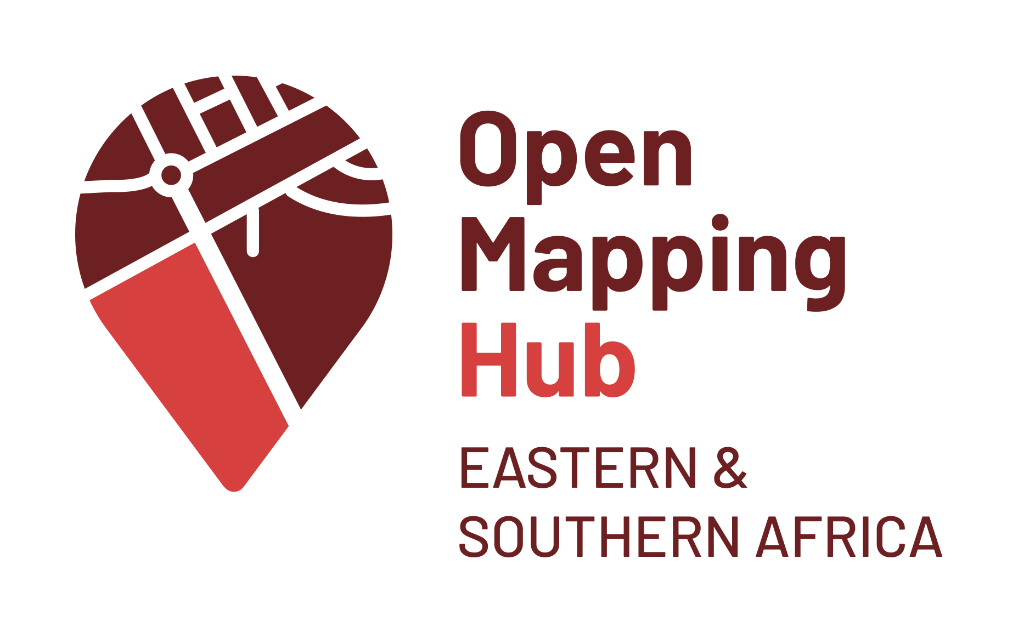
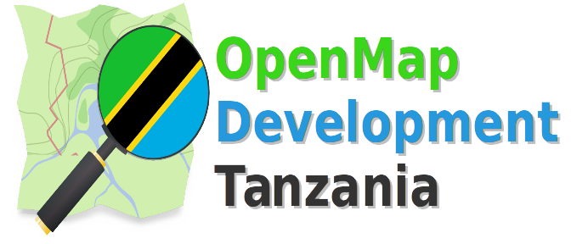
Acknowledgement
Collaborators, Stakeholders and Users
A range of NGO, government, community-based organizations (OSM community groups) and universities
^{Author: David Luswata}
Affiliation: Humanitarian OpenStreetMap Team (HOT)
Email: david.luswata@hotosm.org
partnerships@hotosm.org | ESAhub@hotosm.org | WNAHub@hotosm.org

Slide 14
Thank you
Questions?

